Slide 1
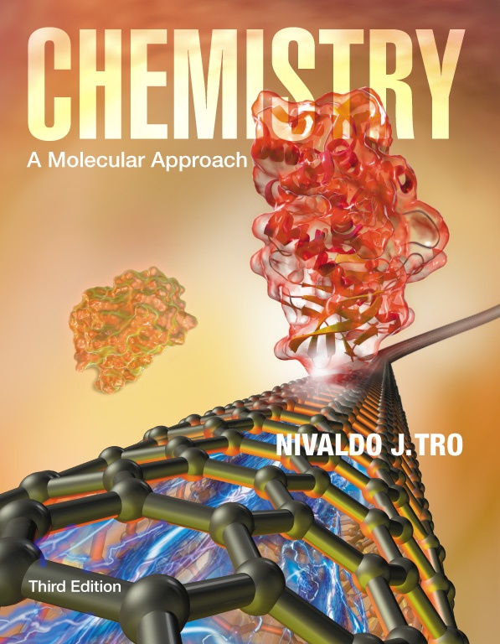
Lecture Presentation
Chapter 1
Matter, Measurement,
and Problem Solving
Christian Madu, Ph.D.
Collin College

Slide 2
What Do You Think?
Atoms and molecules determine how matter behaves; if they were different, matter would be different.
  The properties of water molecules determine how water behaves; the properties of sugar molecules determine how sugar behaves.
The understanding of matter at the molecular level gives us unprecedented control over that matter.

Slide 3
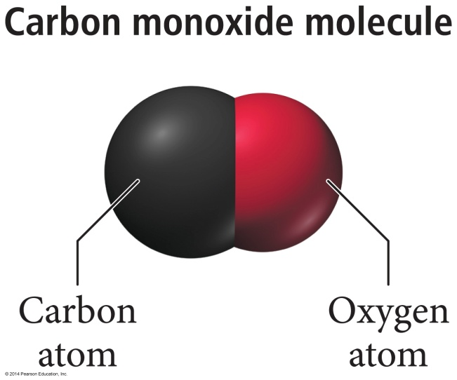
Atoms and Molecules
The air contains carbon monoxide pollutant.
Carbon monoxide gas is composed of carbon monoxide molecules.
Each molecule contains a carbon atom and an oxygen atom held together by a chemical bond.

Slide 4
Atoms and Molecules
Atoms are the submicroscopic particles that constitute the fundamental building blocks of ordinary matter.
Free atoms are rare in nature; instead they bind together in specific geometrical arrangements to form molecules.

Slide 5
The Classification of Matter
Matter is anything that occupies space and has mass.
    Your textbook, your desk, your chair, and even your body are all composed of matter.
We can classify matter according to its state (its physical form) and its composition (the basic components that make it up).

Slide 6
The States of Matter
Matter can be classified as solid, liquid, or gas based on what properties it exhibits.
The state of matter changes from solid to liquid to gas with increasing temperature.

Slide 7
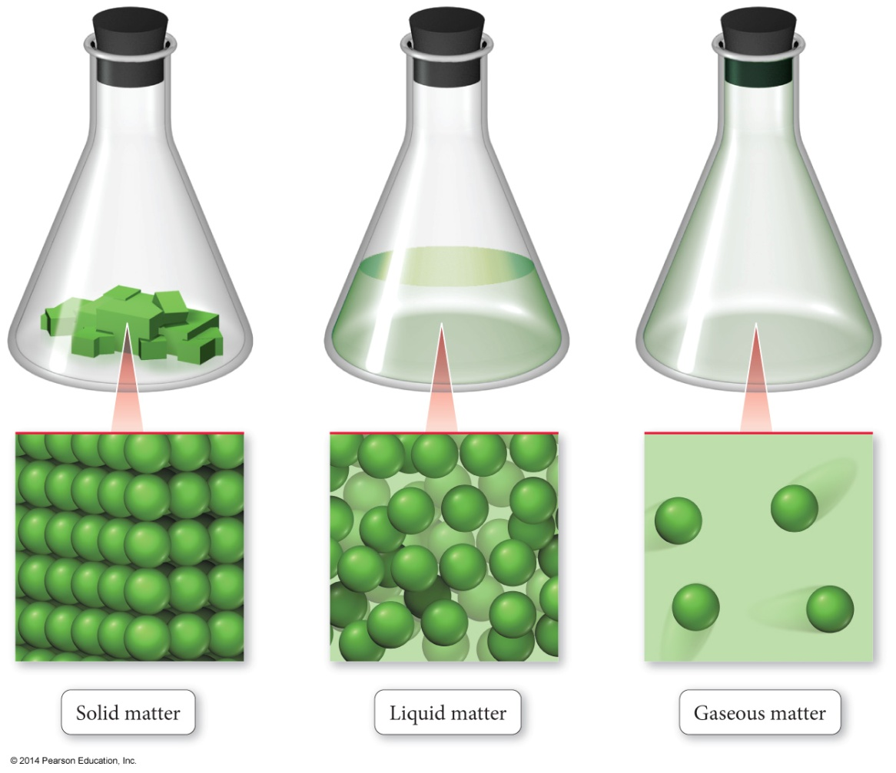
Structure Determines Properties
The atoms or molecules have different structures in solids, liquids, and gases—leading to different properties.

Slide 8
Solid Matter
In solid matter, atoms or molecules pack close to each other in fixed locations.
Although the atoms and molecules in a solid vibrate, they do not move around or past each other.
Consequently, a solid has a fixed volume and rigid shape.
    Ice, aluminum, and diamond are good examples
    of solids.

Slide 9
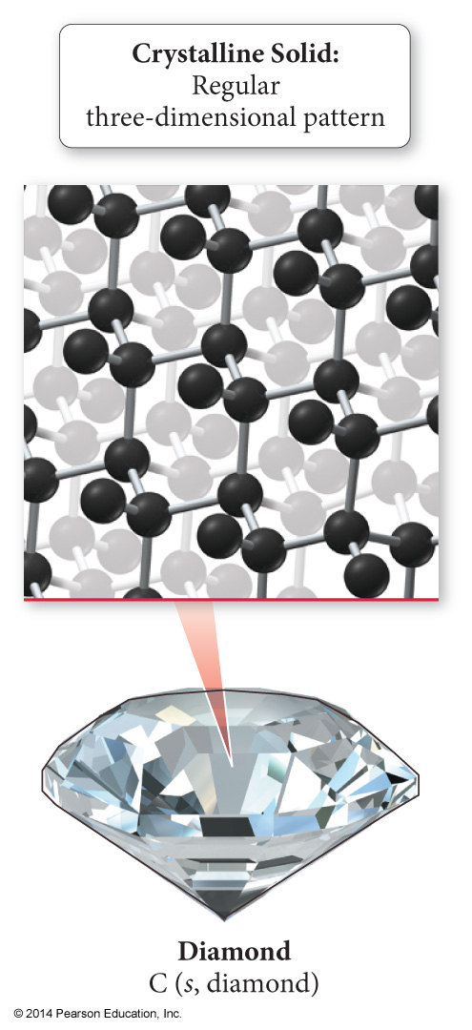
Solid Matter
Solid matter may be crystalline—in which case its atoms or molecules are in patterns with long-range, repeating order.
    Table salt and diamond are examples of solid matter.
Others may be amorphous, in which case its atoms or molecules do not have any long-range order.
    Examples of amorphous solids include glass and plastic.

Slide 10
Liquid Matter
In liquid matter, atoms or molecules pack about as closely as they do in solid matter, but they are free to move relative to
each other.
Liquids have fixed volume but not a
fixed shape.
Liquids’ ability to flow makes them assume the shape of their container.
    Water, alcohol, and gasoline are all substances that are liquids at room temperature.

Slide 11
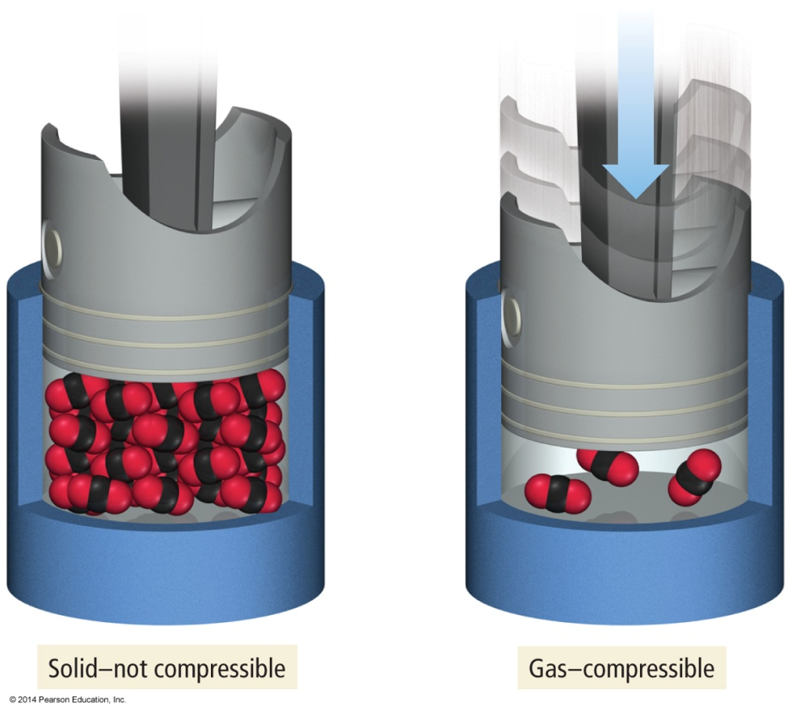
Gaseous Matter
In gaseous matter, atoms or molecules have a lot of space between them.
They are free to move relative to one another.
These qualities make gases compressible.

Slide 12
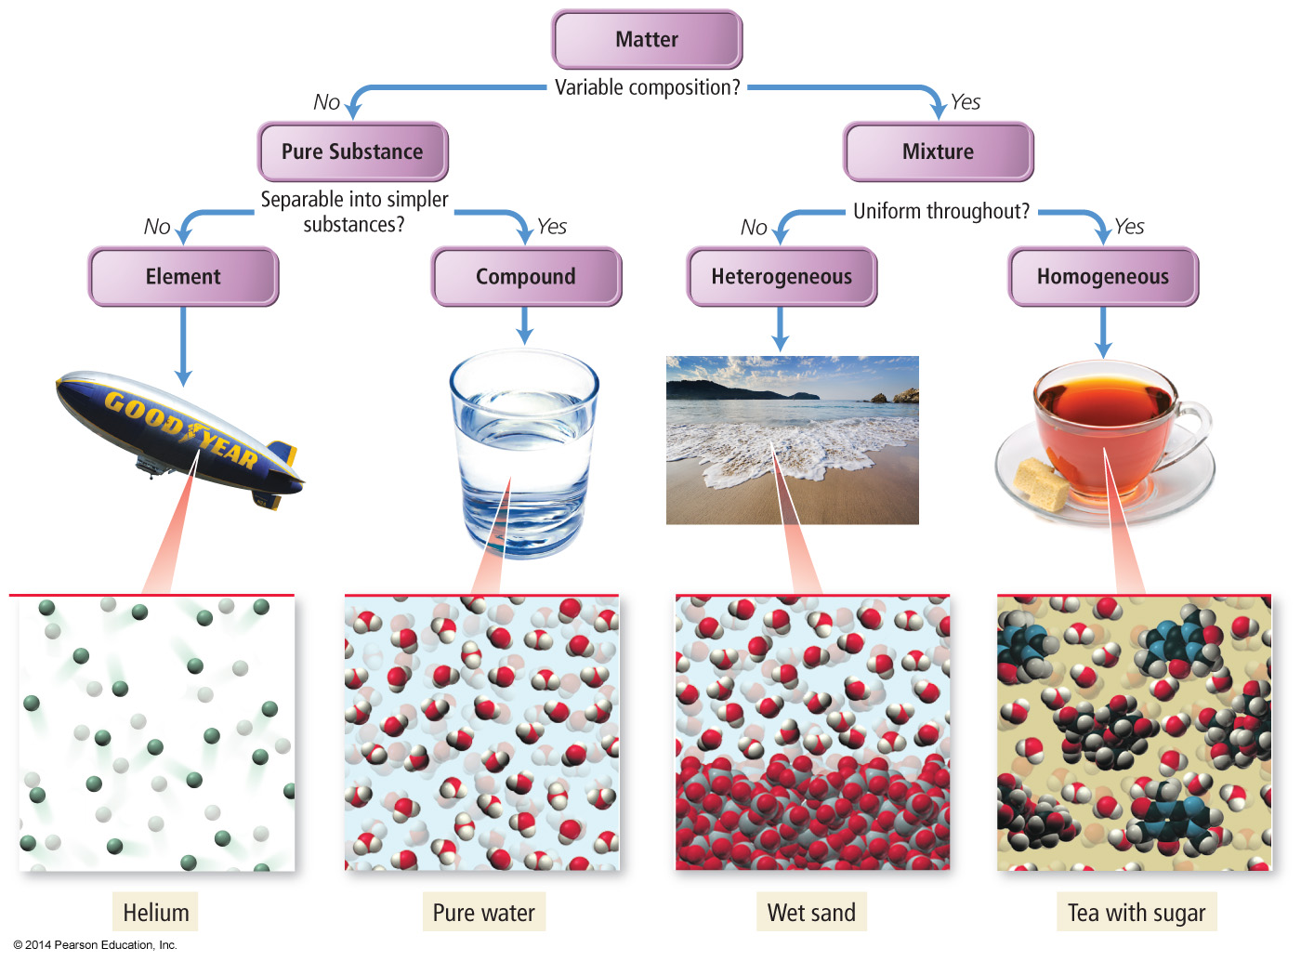
The Classification of Matter by Components
Matter can also be classified according to its composition: elements, compounds, and mixtures.

Slide 13
Classification of Matter by Components
The first division in the classification of matter is between a pure substance and a mixture.
A pure substance is made up of only one component and its composition is invariant.
A mixture, by contrast, is a substance composed of two or more components in proportions that can vary from one sample to another.

Slide 14
Classification of Pure Substances
Pure substances categorize into two types:
    Elements
    Compounds
This categorization depends on whether or not they can be broken down (or decomposed) into simpler substances.

Slide 15
Classification of Pure Substances
An element is a substance that cannot be chemically broken down into simpler substances.
    Basic building blocks of matter
    Composed of single type of atom, like helium
A compound is a substance composed of two or more elements in fixed definite proportions.
Most elements are chemically reactive and combine with other elements to form compounds like water, sugar, etc.

Slide 16
Classification of Mixtures
Mixtures can be categorized into two types:
    Heterogeneous mixtures
    Homogeneous mixtures
This categorization of mixture depends on how uniformly the substances within them mix.

Slide 17
Heterogeneous Mixture
A heterogeneous mixture is one in which the composition varies from one region of the mixture to another.
    Made of multiple substances, whose presence can be seen (Example: a salt and sand mixture)
      Portions of a sample of heterogeneous mixture have different composition and properties.

Slide 18
Homogeneous Mixture
A homogeneous mixture is one made of multiple substances, but appears to be one substance.
All portions of a sample have the same composition and properties (like
sweetened tea).
Homogeneous mixtures have uniform compositions because the atoms or molecules that compose them mix uniformly.

Slide 19
Separating Mixtures
Mixtures are separable because the different components have different physical or chemical properties.
Various techniques that exploit these differences are used to achieve separation.
A mixture of sand and water can be separated by decanting—carefully pouring off the water into another container.

Slide 20
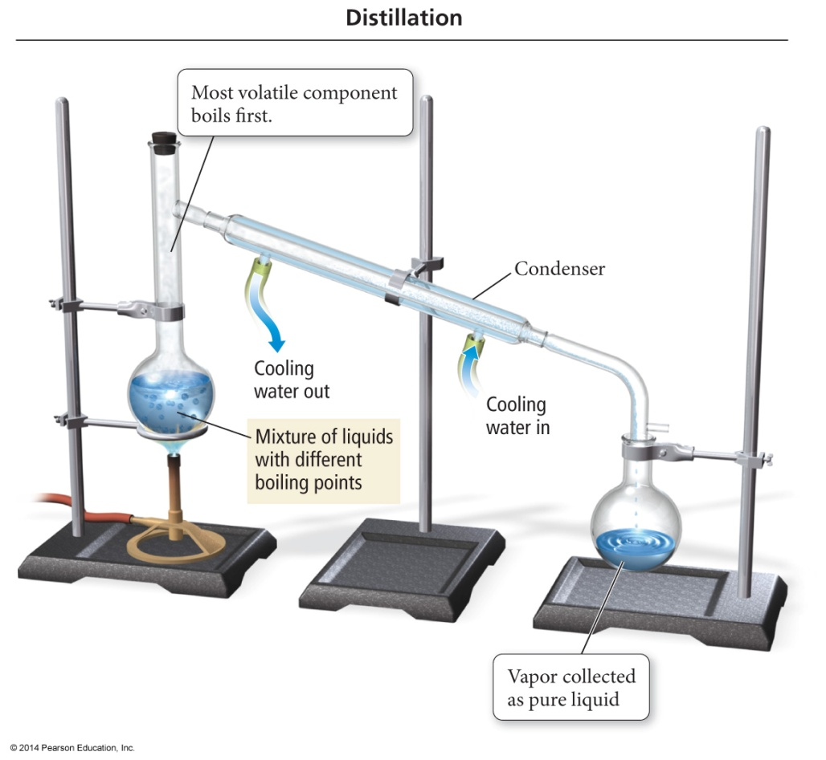
Separating Mixtures
A homogeneous mixture of liquids can usually be separated by distillation, a process in which the mixture is heated to boil off the more volatile (easily vaporizable) liquid. The volatile liquid is then re-condensed in a condenser and collected in a separate flask.

Slide 21
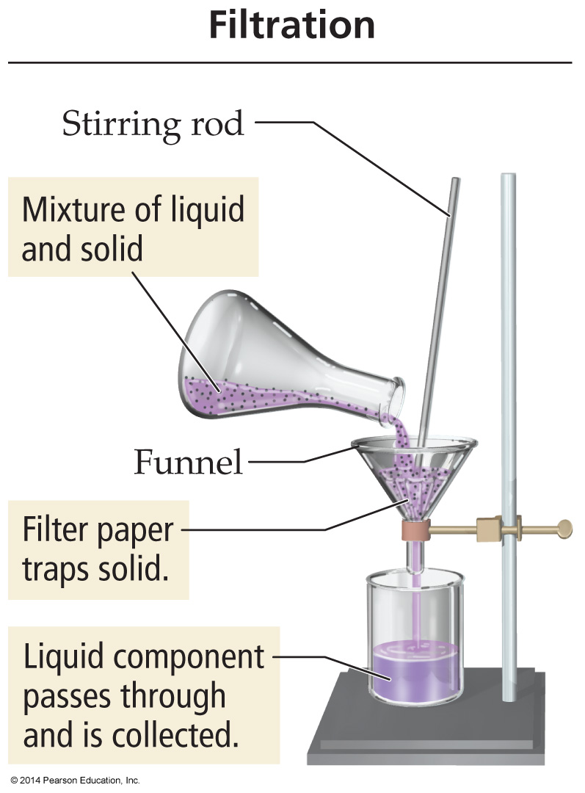
Separating Mixtures
A mixture of an insoluble solid and a liquid can be separated by filtration—process in which the mixture is poured through filter paper in a funnel.

Slide 22
Physical and Chemical Changes
Physical Change:
Changes that alter only the state or appearance, but not composition, are physical changes.
The atoms or molecules that compose a substance do not change their identity during a physical change.

Slide 23
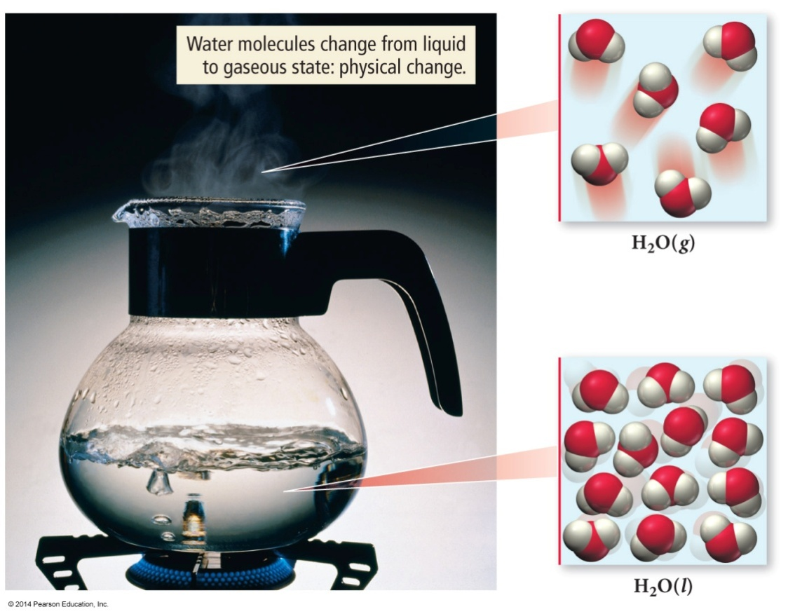
Physical Change
When water boils, it changes its state from a liquid to a gas.
The gas remains composed of water molecules, so this is
a physical change.

Slide 24
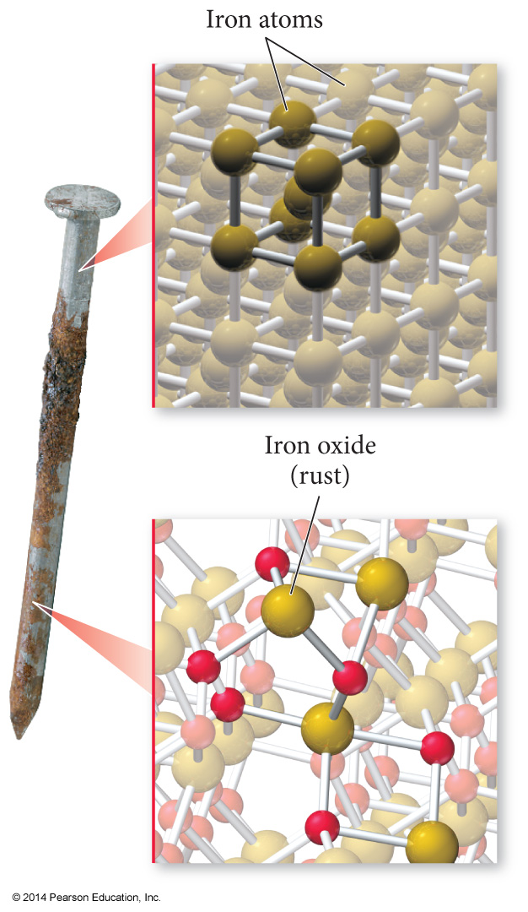
Chemical Change
Changes that alter the composition of matter are chemical changes.
During a chemical change, atoms rearrange, transforming the original substances into different substances.
Rusting of iron is a chemical change.

Slide 25
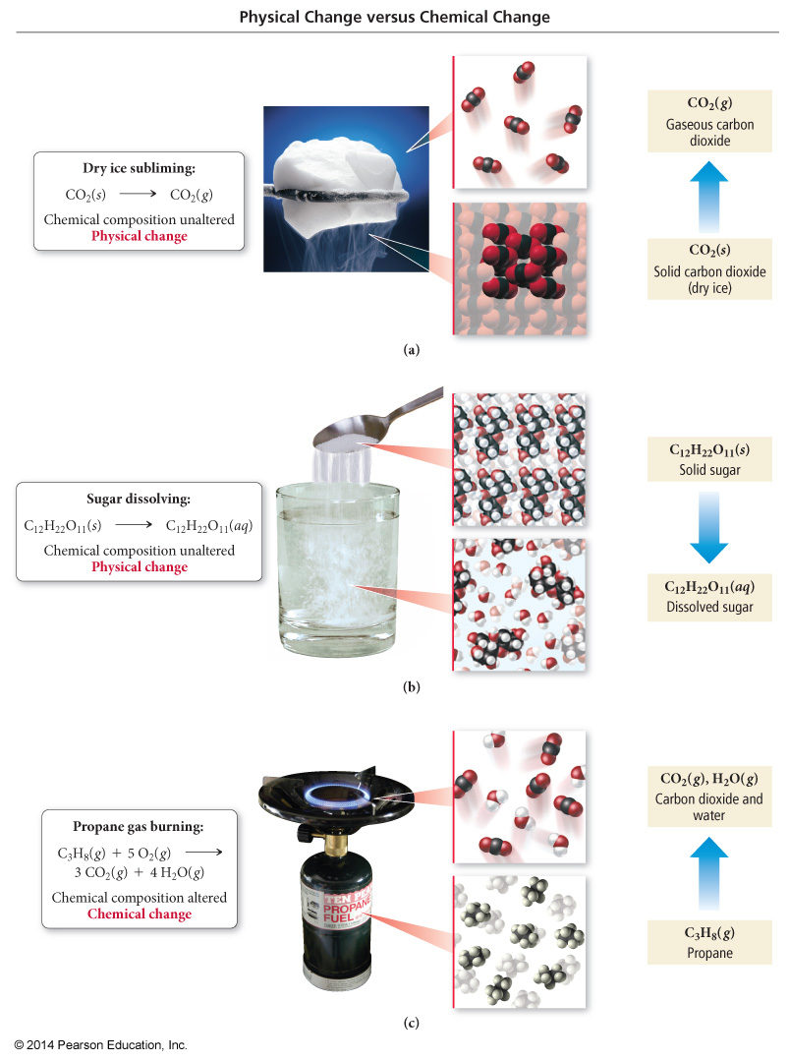
Physical and Chemical Changes

Slide 26
Physical and Chemical Properties
A physical property is a property that a substance displays without changing its composition.
    The smell of gasoline is a physical property.
    Odor, taste, color, appearance, melting point, boiling point, and density are all physical properties.
A chemical property
is a property that a substance displays
only by changing its composition via a chemical change (or chemical reaction).
    The flammability of gasoline, in contrast, is a chemical property.
    Chemical properties include corrosiveness, acidity, and toxicity.

Slide 27
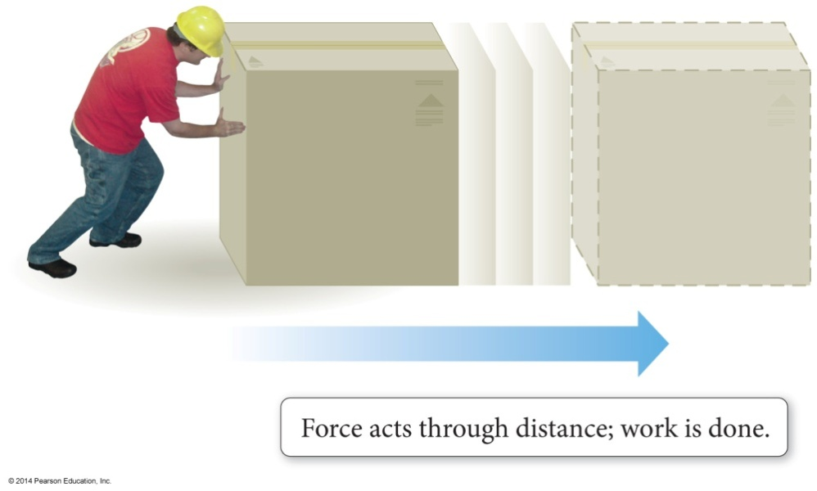
Energy: A Fundamental Part of Physical and Chemical Change
Energy is the capacity to do work.
Work is defined as the action of a force through a distance.
When you push a box across the floor or pedal your bicycle across the street, you have done work.

Slide 28
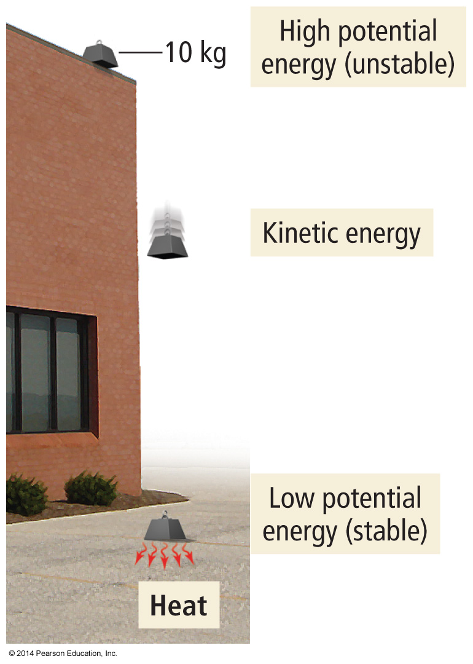
Energy
Kinetic energy is the energy associated with the motion of
an object.
Potential energy is the energy associated with the position or composition of an object.
Thermal energy is the energy associated with the temperature of an object.
    Thermal energy is actually a type of kinetic energy because it arises from the motion of the individual atoms or molecules that make up an object.

Slide 29
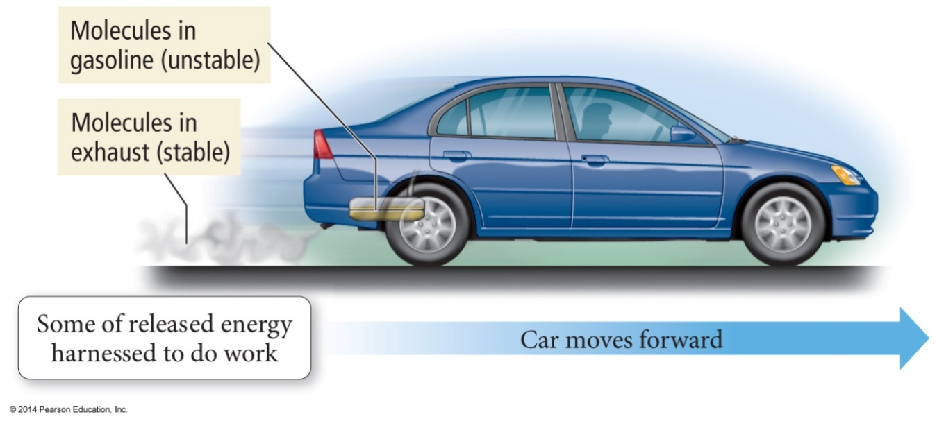
Summarizing Energy
Energy is always conserved in a physical or chemical change; it is neither created nor destroyed (law of conservation of energy).
Systems with high potential energy tend to change in a direction that lowers their potential energy, releasing energy into the surroundings.

Slide 30
The Units of Measurement
In chemistry, units—standard quantities used to specify measurements—are critical.
The two most common unit systems are as follows:
    Metric system, used in most of the world
    English system, used in the United States
Scientists use the International System of Units (SI), which is based on the metric system.
    The abbreviation SI comes from the French, phrase Système International d’Unités.

Slide 31
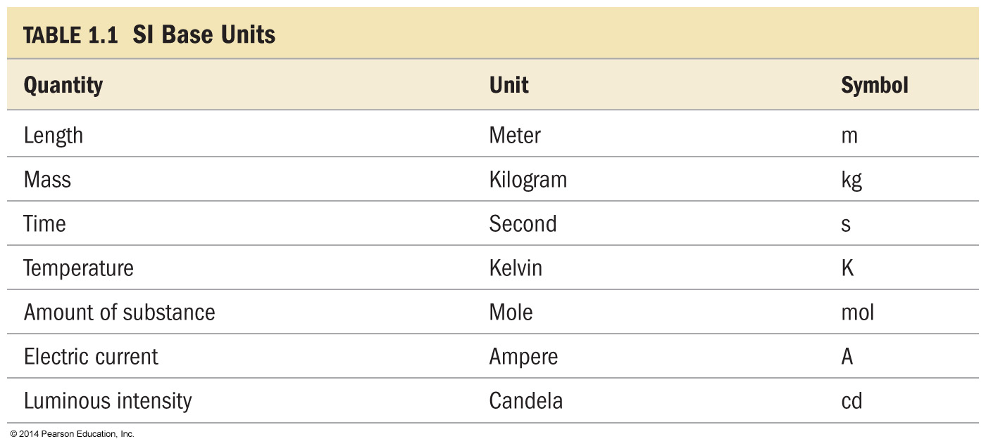
The Standard Units

Slide 32
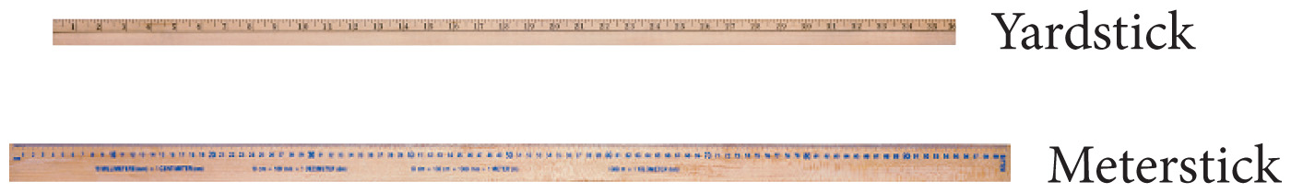
The Meter: A Measure of Length
The meter (m) is slightly longer than a yard (1 yard is 36 inches, while 1 meter is 39.37 inches).
1 meter = 1/10,000,000 of the distance from the equator to the North Pole (through Paris).
    The International Bureau of Weights and Measures now defines it more precisely as the distance light travels through a vacuum in a certain period of time, 1/299,792,458 second.

Slide 33
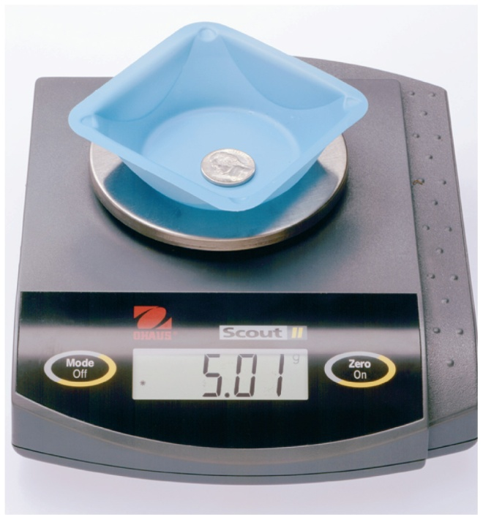
The Kilogram: A Measure of Mass
The mass of an object is a measure of the quantity of matter within it.
The SI unit of mass = kilogram (kg).
    1 kg = 2 lb 3 oz
A second common unit of mass is the gram (g).
    One gram is 1/1000 kg.
Weight of an object is a measure of the gravitational pull on its matter.

Slide 34
The Second: A Measure of Time
Measure of the duration of an event
SI units = second (s)
1 s is defined as the period of time it takes for a specific number of radiation events of a specific transition from cesium-133.

Slide 35
The Kelvin: A Measure of Temperature
The Kelvin (K) is the SI unit of temperature.
The temperature is a measure of the average amount of kinetic energy of the atoms or molecules that compose the matter.
Temperature also determines the direction of thermal energy transfer, or what we commonly call heat.
Thermal energy transfers from hot to cold objects.

Slide 36
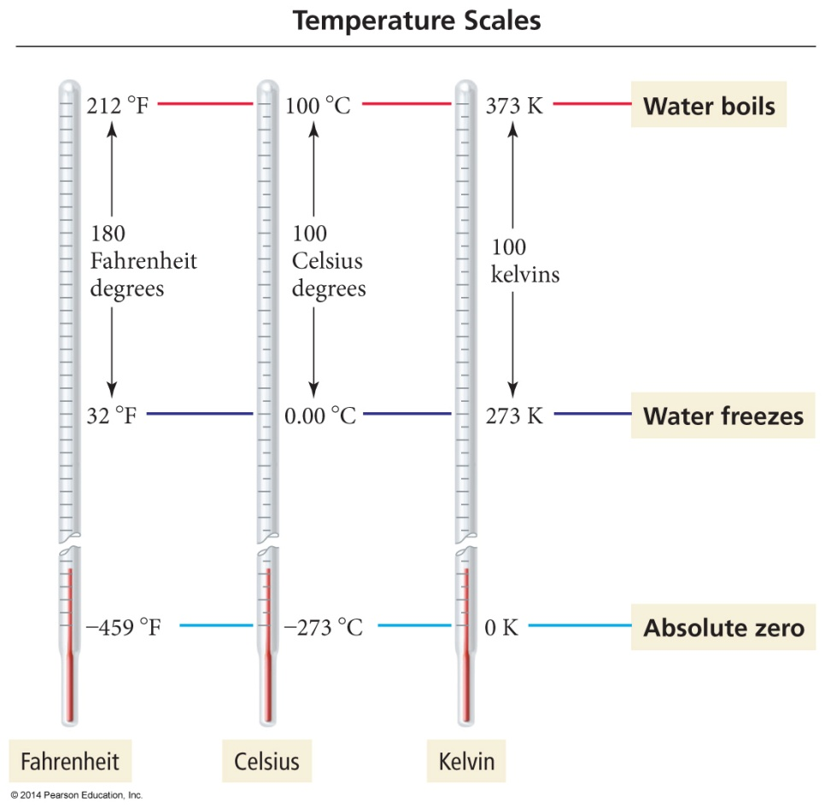
The Kelvin: A Measure of Temperature
Kelvin scale (absolute scale) assigns 0 K (absolute zero) to the coldest temperature possible.
Absolute zero (–273 °C or –459 °F) is the temperature at which molecular motion virtually stops. Lower temperatures do not exist.

Slide 37
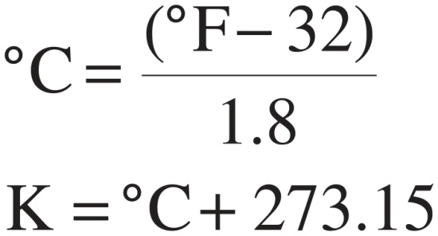
A Measure of Temperature
The Fahrenheit degree is five-ninths the size of a Celsius degree.
The Celsius degree and the Kelvin degree are the same size.
Temperature scale conversion is done with these formulas:

Slide 38
Prefix Multipliers
The International System of Units uses the prefix multipliers shown in Table 1.2 with the standard units.
These multipliers change the value of the unit by the powers of 10 (just like an exponent does in scientific notation).
For example, the kilometer has the prefix kilo meaning 1000 or 10³.

Slide 39
Counting Significant Figures
Significant figures deal with writing numbers to reflect precision.
The precision of a measurement depends on the instrument used to make the measurement.
The preservation of this precision during calculations can be accomplished by using significant figures.

Slide 40
Counting Significant Figures
The greater the number of significant figures, the greater the certainty of the measurement.
To determine the number of significant figures in a number, follow these rules (examples are on the right).
Significant Figure Rules |  | Examples
1. All nonzero digits are significant | 28.03 | 0.0540
2. Interior zeroes (zeroes between two nonzero digits) are significant. | 408 | 7.0301

Slide 41
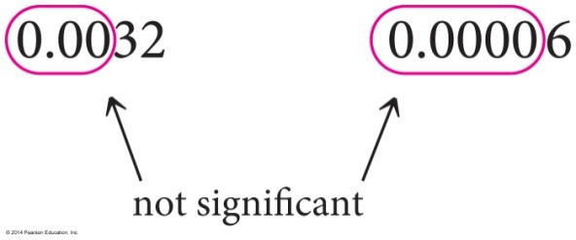
Counting Significant Figures
Significant Figure Rules |  | Examples
3. Leading zeroes (zeroes to the left of the first nonzero digit) are not significant. They only serve to locate the decimal point.
4. Trailing zeroes (zeroes at the end of a number) are categorized as follows: | 45.000 | 3.5600
Trailing zeroes after a decimal point are always significant.
Trailing zeroes before a decimal point (and after a nonzero number) are always significant. | 140.00 | 2500.55
Trailing zeroes before an implied decimal point are ambiguous and should be avoided by using scientific notation. | 1200 1.2 × 10³ 1.20 × 10³ 1.200 × 10³ | Ambiguous 2 significant figures 3 significant figures 4 significant figures
Decimal points are placed after one or more trailing zeroes if the zeroes are to be considered significant. | 1200. | 4 significant figures

Slide 42
Exact Numbers
Exact numbers have an unlimited number of significant figures.
Exact counting of discrete objects
Integral numbers that are part of an equation
Defined quantities
Some conversion factors are defined quantities, while others are not.

Slide 43
Significant Figures in Calculations
In calculations using measured quantities, the results of the calculation must reflect the precision of the measured quantities.
We should not lose or gain precision during mathematical operations.

Slide 44
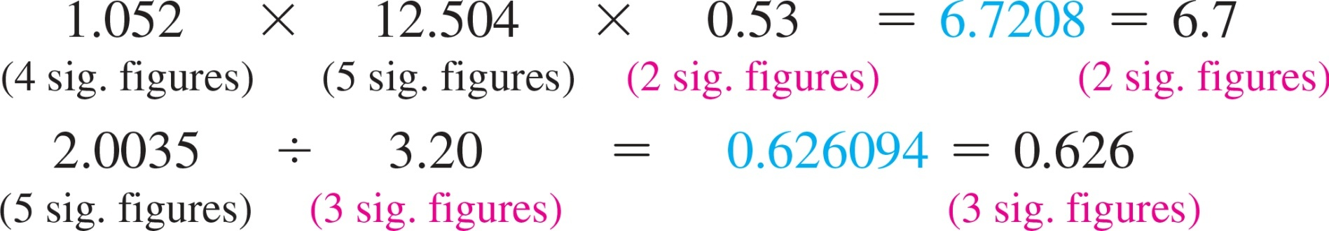
Significant Figure: Rules for Calculations
Multiplication and Division Rule:
In multiplication or division, the result carries the same number of significant figures as the factor with the fewest significant figures.

Slide 45
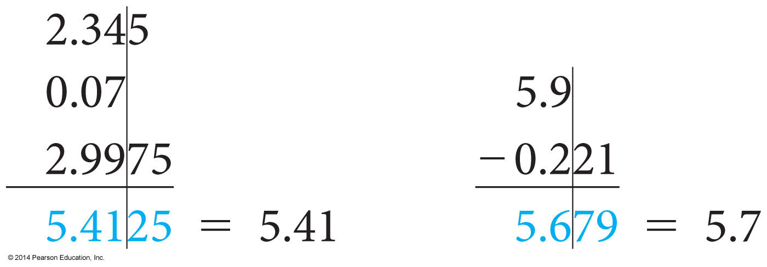
Rules for Calculations
Addition and Subtraction Rule:
In addition or subtraction the result carries the same number of decimal places as the quantity with the fewest decimal places.
It is helpful to draw a line next to the number with the fewest decimal places. This line determines the number of decimal places in the answer.

Slide 46
Rules for Calculations
Rules for Rounding:
When rounding to the correct number of significant figures,
    round down if the last (or leftmost) digit dropped is four or less;
    round up if the last (or leftmost) digit dropped is five or more.

Slide 47
Rules for Rounding
Round to two significant figures:
5.37 rounds to 5.4
5.34 rounds to 5.3
5.35 rounds to 5.4
5.349 rounds to 5.3
Notice in the last example that only the last (or leftmost) digit being dropped determines in which direction to round—ignore all digits to the right of it.

Slide 48
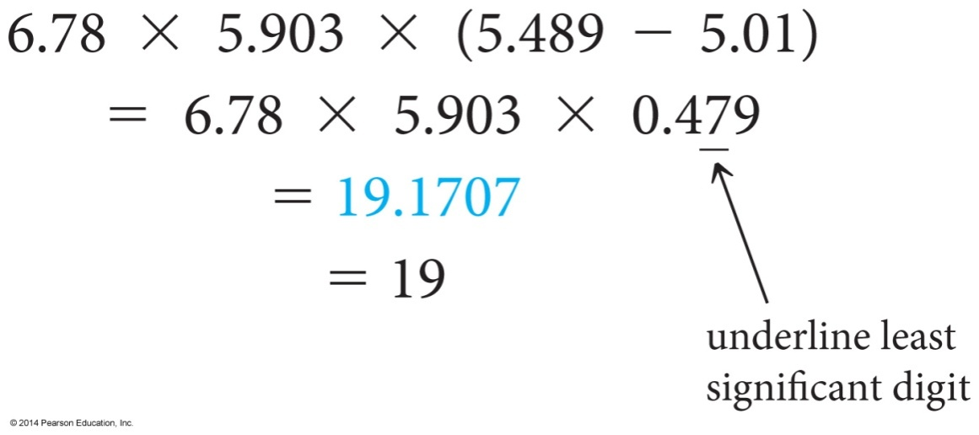
Rounding in Multistep Calculations
To avoid rounding errors in multistep calculations round only the final answer.
Do not round intermediate steps. If you write down intermediate answers, keep track of significant figures by underlining the least significant digit.

Slide 49
Precision and Accuracy
Accuracy refers to how close the measured value is to the actual value.
Precision refers to how close a series of measurements are to one another or how reproducible they are.

Slide 50
Precision and Accuracy
Consider the results of three students who repeatedly weighed a lead block known to have a true mass of 10.00 g (indicated by the solid horizontal blue line on the graphs).
 | Student A | Student B | Student C
Trial 1 | 10.49 g | 9.78 g | 10.03 g
Trial 2 | 9.79 g | 9.82 g | 9.99 g
Trial 3 | 9.92 g | 9.75 g | 10.03 g
Trial 4 | 10.31 g | 9.80 g | 9.98 g
Average | 10.13 g | 9.79 g | 10.01 g

Slide 51
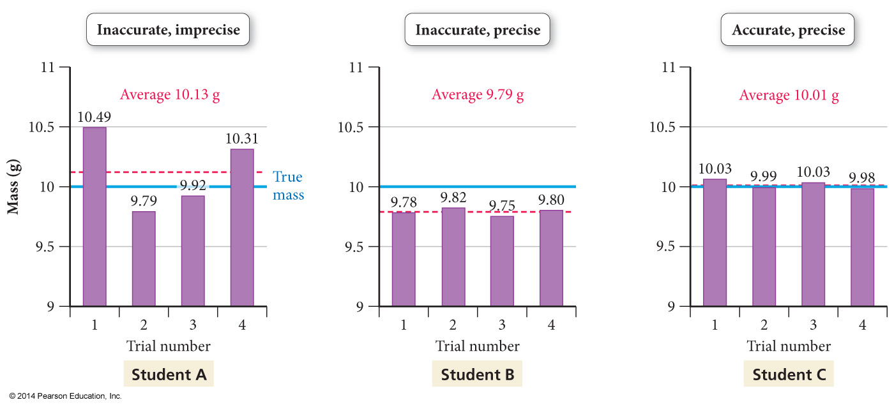
Precision and Accuracy
Measurements are said to be
    precise if they are consistent with one another.
    accurate only if they are close to the actual value.

Slide 52
Precision and Accuracy
The results of student A are both inaccurate (not close to the true value) and imprecise (not consistent with one another).
    Random error is an error that has the equal probability of being too high or too low.
The results of student B are precise (close to one another in value), but inaccurate.
    Systematic error is an error that tends toward being either too high or too low.
The results of student C display little systematic error or random error—they are both accurate and precise.

Slide 53
Solving Chemical Problems
Most chemistry problems you will solve in this course are unit conversion problems.
Using units as a guide to solving problems is called dimensional analysis.
Units should always be included in calculations; they are multiplied, divided, and canceled like any other algebraic quantity.

Slide 54
Dimensional Analysis
A unit equation is a statement of two equivalent quantities, such as
2.54 cm = 1 in.
A conversion factor is a fractional quantity of a unit equation with the units we are converting from on the bottom and the units we are converting to on the top.

Slide 55
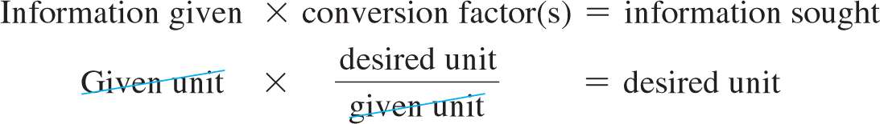
Dimensional Analysis
Most unit conversion problems take the following form:

Slide 56
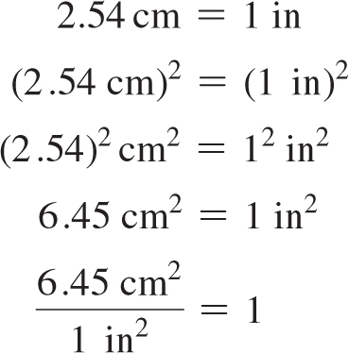
Dimensional Analysis
Units Raised to a Power:
When building conversion factors for units raised to a power, remember to raise both the number and the unit to the power. For example, to convert from in² to cm², we construct the conversion factor as follows:

